Slide 1

AI Customer Support Reply Evaluator
Amr Asmar & Nancy Al-Jabbarin
Natural Language Processing · Dr. Hamed Abdelhaq
An-Najah National University · May 28, 2026

Slide 2
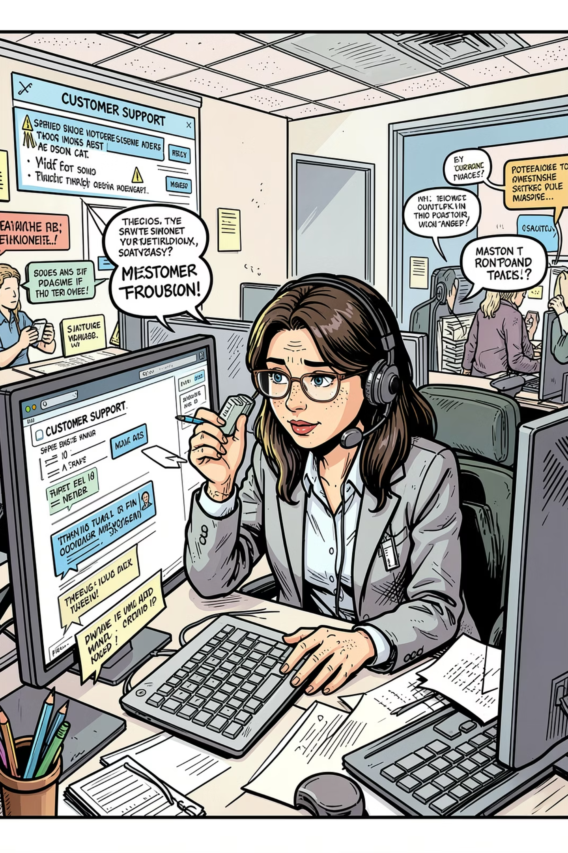

Problem Statement & Motivation
Manual Evaluation is Unsustainable
Human evaluators are slow, expensive, and inconsistent — impractical at scale.
Inter-Evaluator Inconsistency
Human scorers frequently disagree, introducing subjectivity and bias into quality assessment.
Need for Automated Rubric-Based Scoring
A standardized rubric ensures consistent, reproducible evaluation across diverse support scenarios.
Explainable AI Motivation
Stakeholders require transparent, interpretable rationales — not just scores — to trust automated systems.

Slide 3
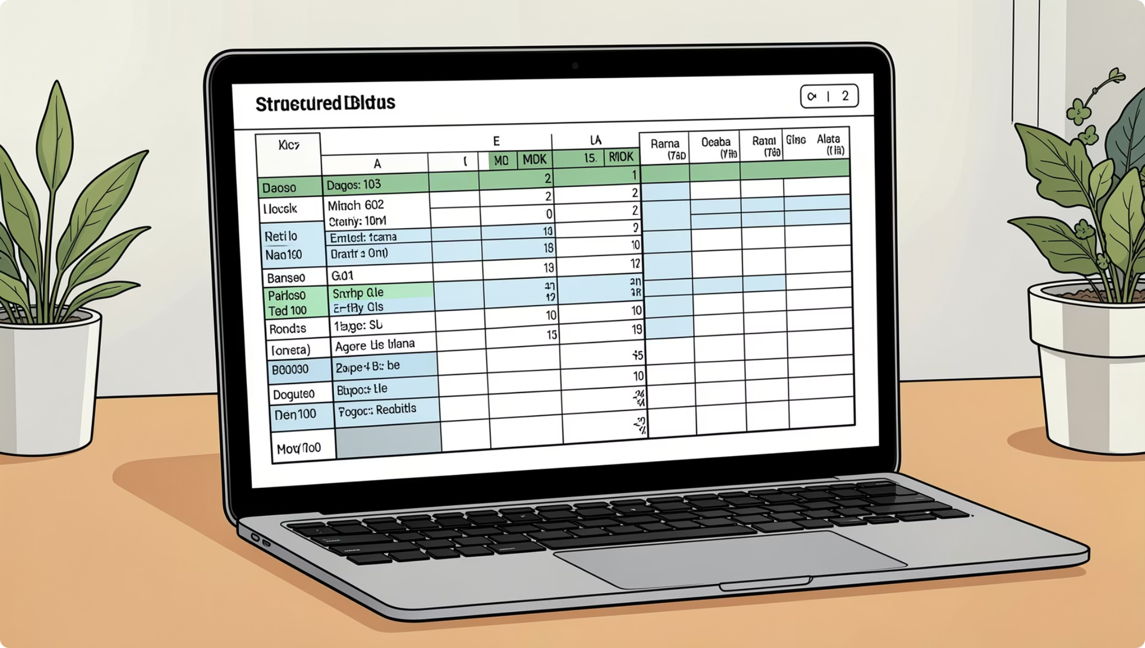
Dataset Overview
200 Manually Curated Samples
AI-assisted generation followed by rigorous human review ensures high-quality, realistic support interactions.
Scenarios covered: Delayed orders, refunds, damaged products, payment issues, login problems, and general inquiries.
Dataset fields: task, reference, submission, rubric, score, rationale
Score Range
Scenarios
0 – 4 (balanced)
30+ customer support scenario categories

Slide 4
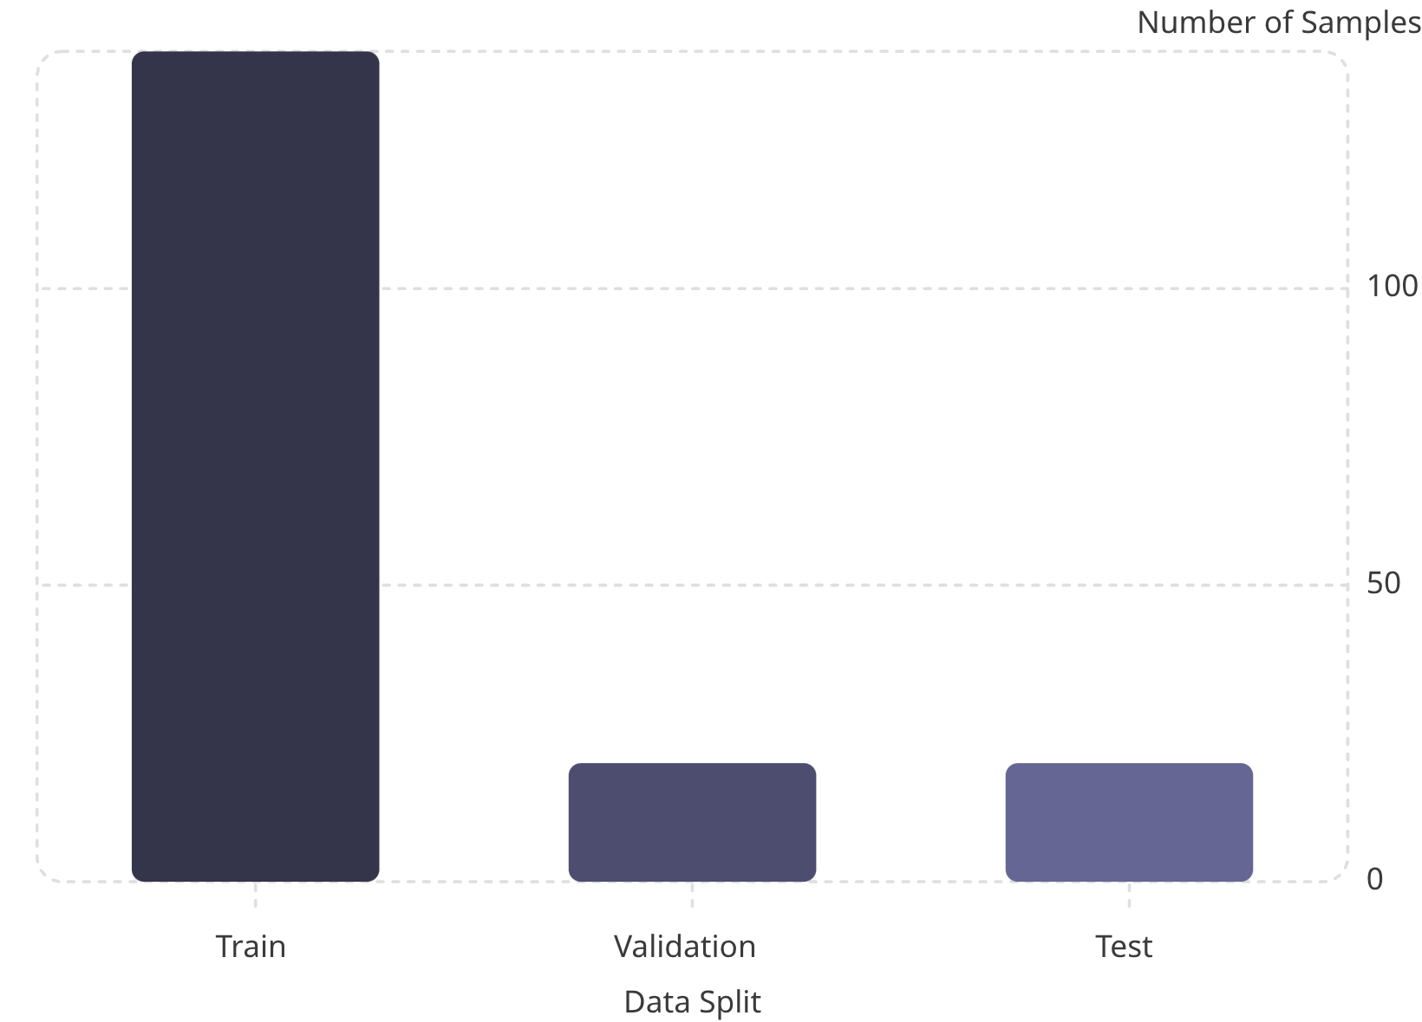
Exploratory Data Analysis
Key EDA Findings
No missing values — complete records across all six fields
Balanced class distribution across score categories (0–4)
Stratified sampling preserves score ratios in train/val/test splits
Text length analysis confirms varied submission and reference complexity

Slide 5
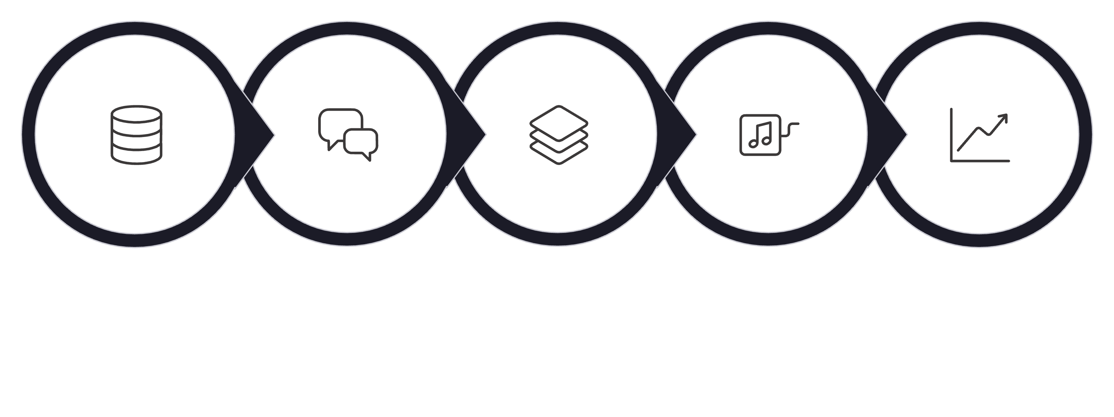
Methodology & Pipeline
Baseline Model
LoRA Fine-Tune
Dataset Prep
Prompt Eng
Evaluation
The workflow begins with dataset preparation and prompt design, then then evaluates the baseline model before applying LoRA fine-tuning Performance is validated using accuracy, MAE, and QWK, and the best model is deployed via an interactive Gradio interface.

Slide 6

Model & Technologies
Mistral-7B-Instruct-v0.2
4-Bit Quantization
LoRA Fine-Tuning
Base LLM with strong instruction-following and reasoning capabilities.
Reduces GPU memory footprint, enabling fine-tuning on consumer hardware.
Low-Rank Adaptation injects trainable matrices into attention layers — efficient and effective.
HuggingFace & Unsloth
Gradio UI
Transformers library for model loading; Unsloth accelerates LoRA training by up to 2×.
Interactive web interface for live model demonstration and testing.
Why LoRA? Full fine-tuning is computationally prohibitive. LoRA freezes base weights and trains only low-rank adapters — dramatically reducing parameters while matching full fine-tuning performance.

Slide 7
Prompt Engineering & Output Format
Prompt Structure
Expected Output
01
Score
Rationale
Task
Integer 0–4
Plain-text justification
Customer query description
02
Example Output
Reference
Score: 3Rationale: The response addressesthe refund request clearly andprovides next steps, but lacksan apology and specific timeline.
Ideal support response
03
Submission
Model-generated reply
04
Rubric
Scoring criteria (0–4)

Slide 8
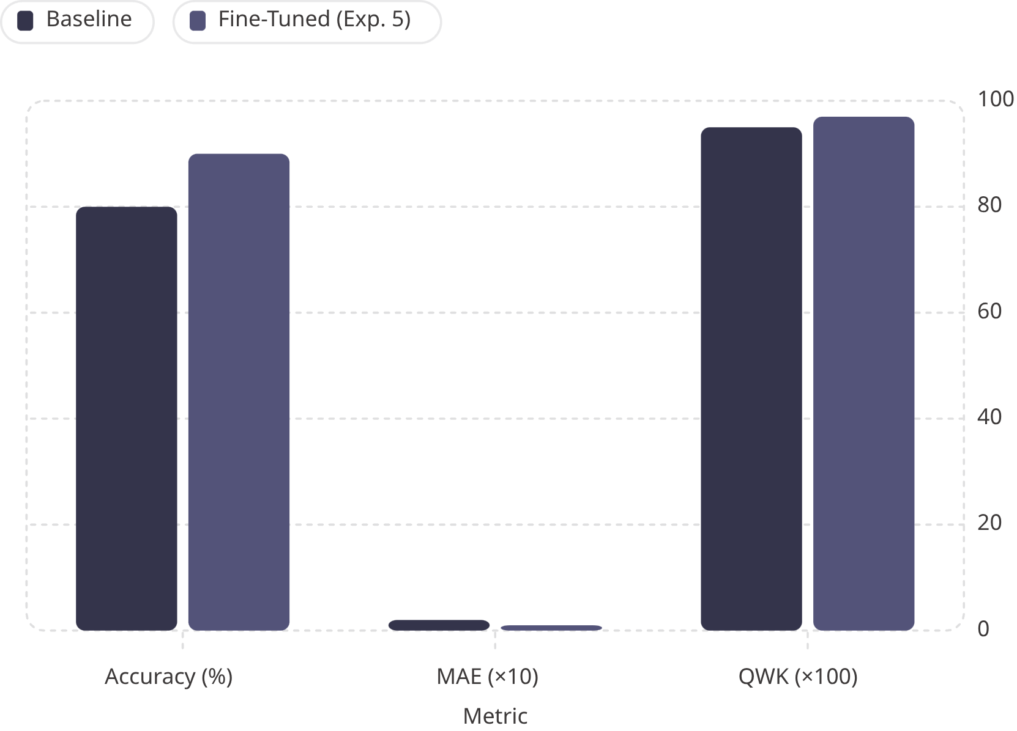

Baseline vs Fine-Tuned Results
Experiment 5 — Best Performance
LoRA fine-tuning delivered consistent improvements across all evaluation metrics, confirming the value of task-specific adaptation.
Metric
Baseline
Fine-Tuned
Accuracy
80%
90%
MAE
0.20
0.10
QWK
0.9545
0.9744
Fine-tuning reduced MAE by 50% and improved QWK, showing stronger agreement with human-assigned scores.

Slide 9
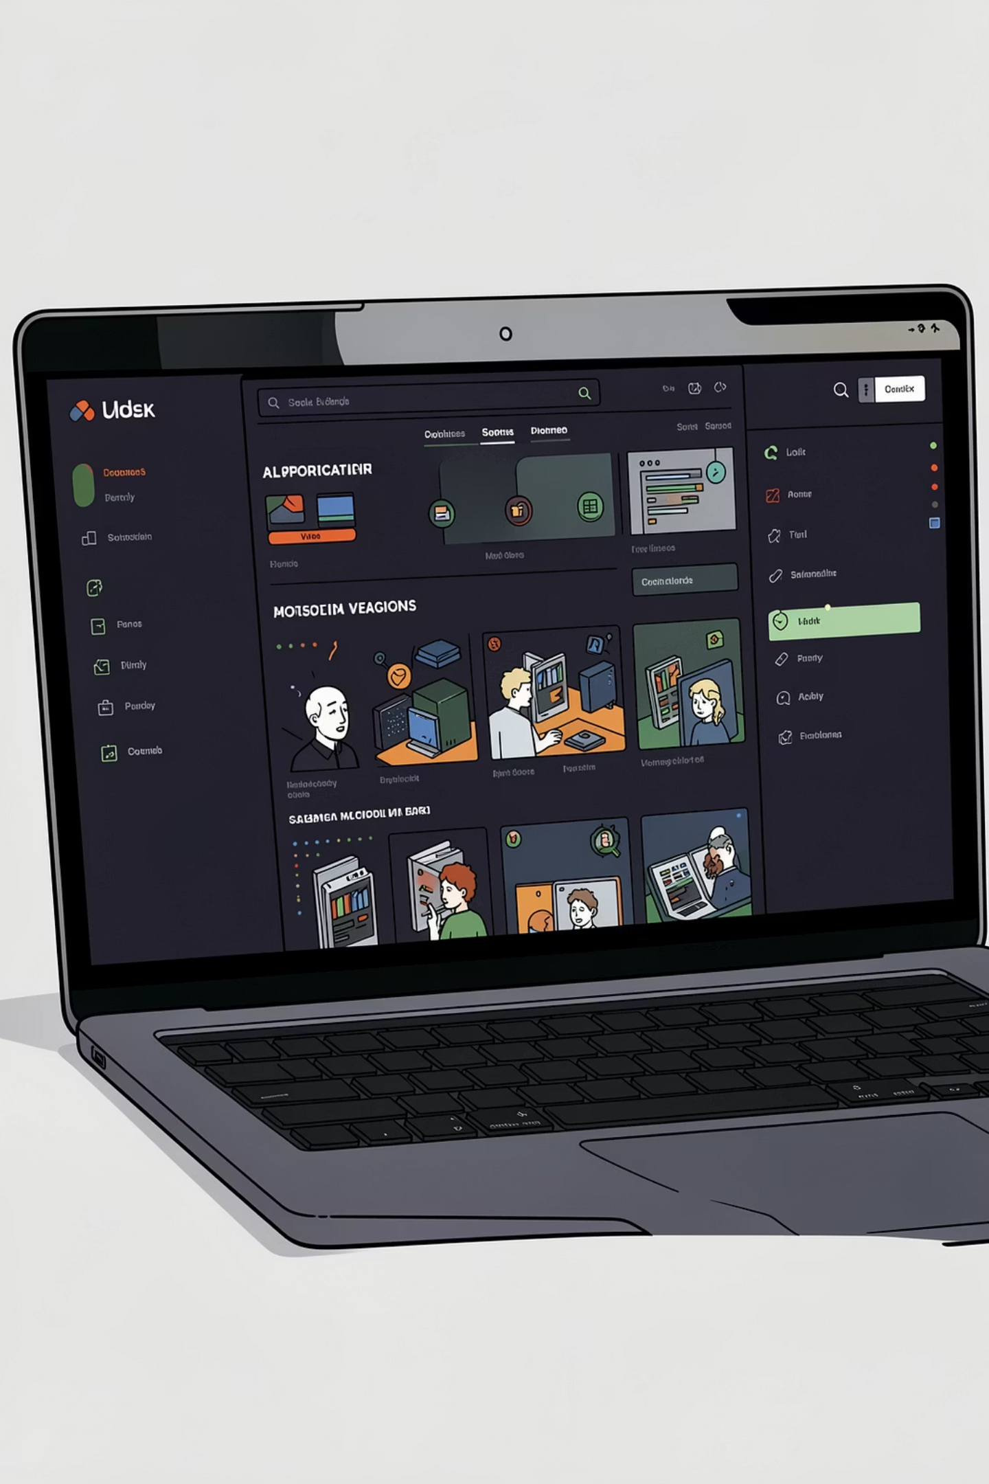
Gradio UI Demo
Interactive Evaluation
Users can submit a support reply and receive an instant score with a rationale.
Generated Examples
The interface can load realistic test examples for quick demonstration.
Hidden Reference
The reference answer is hidden by default to reduce bias during manual testing.
Static Rubric Display
The scoring criteria remain visible to make the evaluation transparent.

Slide 10
Conclusion & Future Work
Key Achievements
Future Directions
Fine-Tuning Delivers
Multilingual Support — Extend evaluation to Arabic and other languages
LoRA adaptation improved accuracy from 80% to 90% with near-perfect QWK.
Larger Datasets — Scale to thousands of diverse support scenarios
Explainable AI Built
The evaluator produces human-readable rationales alongside every score.
Production Deployment — Integrate into live support platforms via API
Per-Rubric Scoring — Break down scores by individual rubric dimension
Rubric-Based Scoring Works
Structured criteria enabled consistent, reproducible automated evaluation.

